Slide 1



AGRICULTURAL CROP YIELD ANALYSIS
(“EMPOWERING AGRICULTURE THROUGH DATA-DRIVEN INSIGHTS”)
PRESENTED BY:
K Joshna Praharsha

Slide 2
Content:
Back story
Problems faced by farmers (past)
Benefits of crop yield analysis
Data understanding Benefits of crop yield analysis
Data cleaning
Data transformation
conclusion

Slide 3
Colour Theory: Region wish data analysis
This color tells about total yield and states
bar chart
Column chart
Area chart
pie chart
This color describes total yield and districts
This describes the total yield and years
This describes the cash crops and food crops

Slide 4
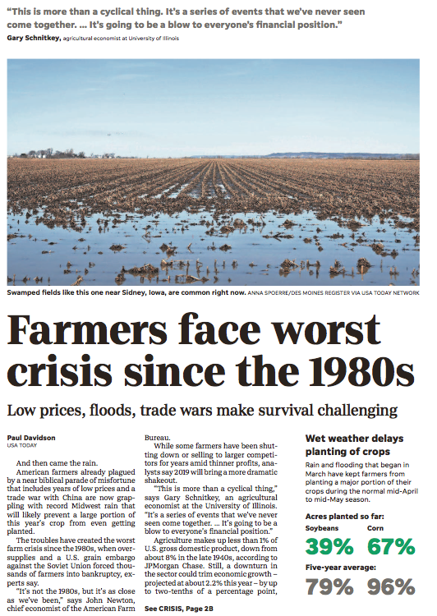
BACK STORY OF AGRICULTURAL CROP YIELD ANALYSIS PROJECT:
Agriculture has always been backbone of Human Civilization . Traditionally, farmers depended on manual observation and make decisions about crop selection ,irrigation ,fertilizers and harvesting this approach often resulted in unpredictable crop yield due to factors like climate changes ,soil degradation ,and pest infestation with out knowledge on cultivations results more expenditure but less yield .
To eradicate the problems faced by farmers we started “Agricultural crop yield Analysis project” ,to predict the future aspects ,The aim of the project is to “study the past farming data” like climate, soil, irrigation, etc that which caused major havoc and rectify by using crop analysis .

Slide 5
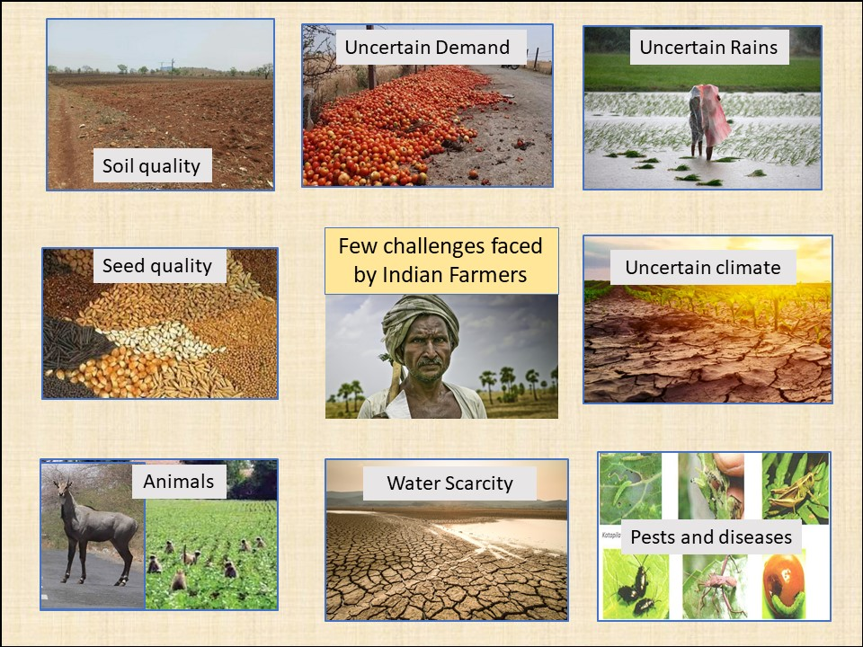
PROBLEMS FACED BY FARMERS(past):
1.unpredictable weather patterns like drought and floods
2.poor irrigation facilities
3.soil fertility depletion
4.impact of climate change
5.low productivity
6.lack of modern farming techniques
7.pest infestation

Slide 6
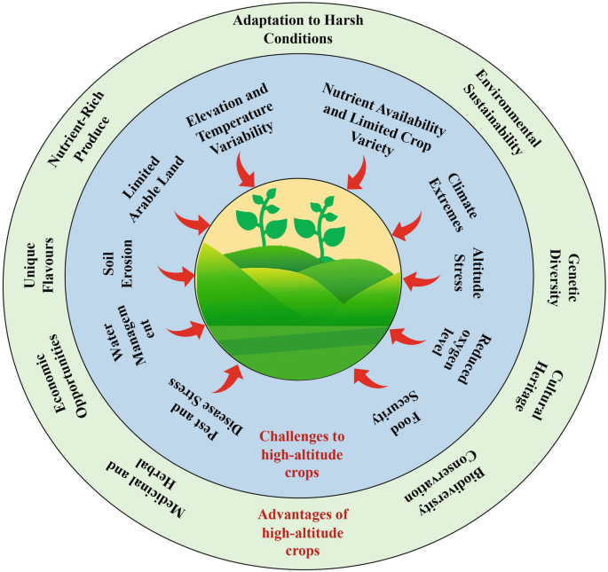
BENEFITS OF CROP YELD ANALYSIS PROJECT:
1.Due to this project ,farmers can estimate how much crop they will harvest .
2.It guides farmers to apply the right amount of irrigation, fertilizer, and pesticides it helps them to save money and gets improved results
3.They can even focus on high return crops ,this help agricultural departments like k .v .k (Krishi vigyan kendra) to do better policies and suggestions to farmers

Slide 7
Data understanding
Understand the meaning and significance of each variable, including crop type, area, production, yield, and environmental conditions such as irrigation , rainfall and temperature. This phase help in forming a metal model
Analyze the significance of environmental and agricultural factors
Helps in developing a metal model of the farming system

Slide 8
Data cleaning:
Removing of duplicates to ensure data consistency , handling missing or blank values.
Fix formatting in columns (e.g: numeric currency ,date format)
Check for nulls values and clean them as needed

Slide 9
Data Transformation:
In Data Analysis refers to process of converting raw data into a format that is more suitable for analysis.
BAR CHART:
This bar chart represents the total crop production values for major agricultural states in india . The values indicate the scale of production and help in comparing output across states:
1.”Bihar” leads with the highest production total 328,725.3units crops like rice , wheat.
2.”Punjab “is least production state total of 278837.96 units.

Slide 10
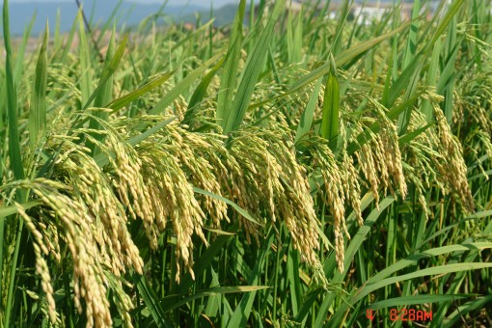
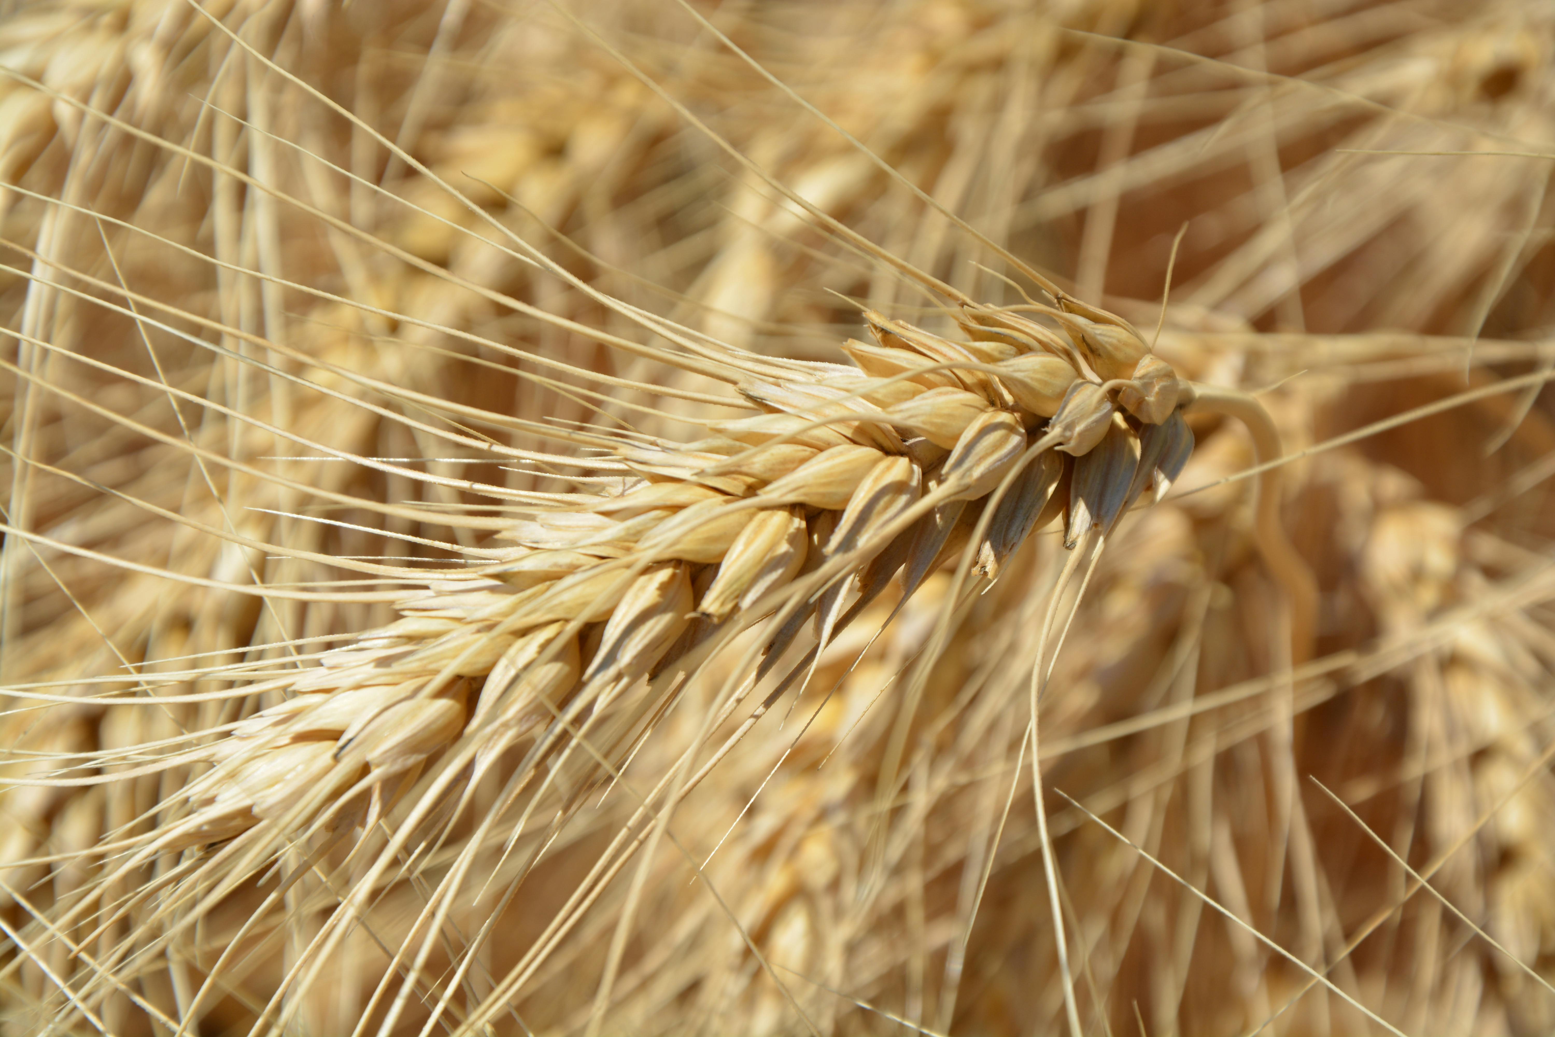
PIE CHART:
This dashboard provides a visual breakdown of crop types ,distinguishing between cash crops and food crops. This pie chart on the right illustrates the Proporation each category:
76% represents food crops which are cultivated and primarily for local consumption e.g: rice, wheat, maize.
24%represents cash crops, which are grown for commercial value and export e.g: cotton ,sugarcane.

Slide 11
AREA chart:
Shows total crop yield trends over years(2010-2023)
Highlights both growth and seasonal production
Peak yield observed around 2012-2013 and 2023
Notable decline in yields between 2015-2020 indicating possible external factors (climate , soil)

Slide 12
CONCLUSION OF PROJECT:
1.Help farmers to choose right crop for the season
2.Reduce droughts and soil erosion , boost food security
3.Government can provide various forms of assistance to farmers like subsidies, schemes
4.Improve productivity , assist risk management

Slide 13

This Photo by Unknown Author is licensed under CC BY-SA

